Slide 1
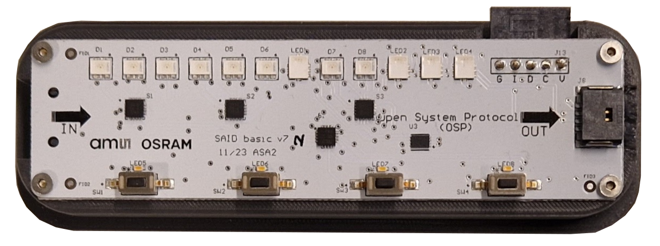
SAIDbasic manual
https://github.com/ams-OSRAM/OSP_aotop/tree/main/examples/saidbasic

Slide 2
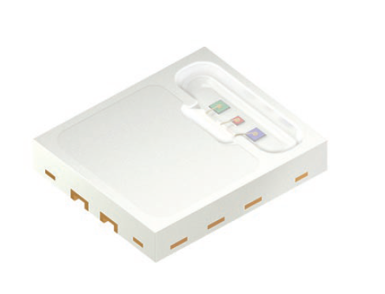
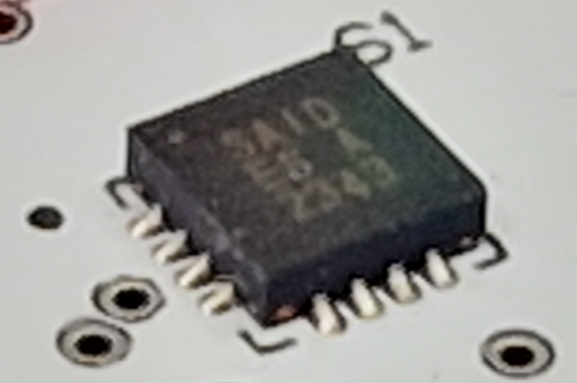
SAID, RGBi and OSP ecosystem
Open System Protocol (OSP)
A protocol, introduced by ams OSRAM, for (automotive indoor) decorative lighting (initially for “OSIRE”)
OSP is an open “standard” and full documentation is available for market players and competitors to implement own devices
ams OSRAM is actively working with partners to build an ecosystem of components around OSP
An OSP system consists of a root MCU with OSP firmware and a daisy chain of up to 1000 OSP compliant nodes
Two node types exist from ams OSRAM: RGBi and SAID
RGBi (or “RGB intelligent ”)
First type of node (available 2023), the E3731i nicknamed RGBi
Contains three (PWM) drivers and three integrated LEDs (red, green, blue)
“intelligent” (=OSP compliant, can send an receive OSP telegrams)
color/temperature calibrated
SAID (or “stand-alone intelligent driver”)
A second type of node (available 2024), the AS1163 nicknamed SAID
Has 9 PWM drivers: 3 channels to drive 3 external RGB modules (or 9 stand-alone LEDs)
One channel can be configured to act as I2C master allowing I2C devices in the OSP chain for example, I2C sensors, or I2C EEPROMs with calibration parameters
It has 2-wire SPI (towards MCU) and group cast

Slide 3
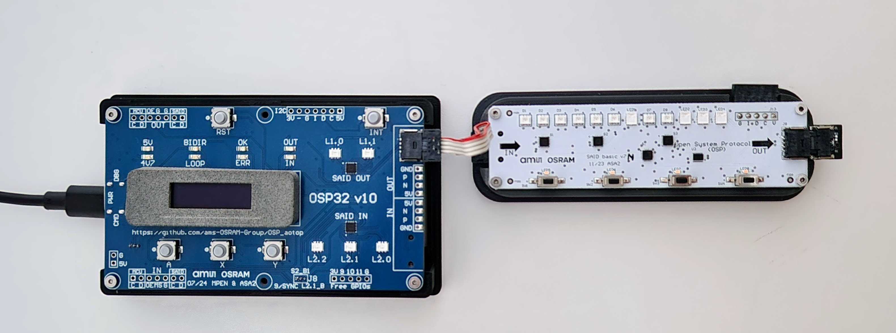
Hardware setup
Status LEDs
SAID (AS1163)
SAID 3×RGB
SAID 2×RGB and I2C
RGBI (E3731i)
Terminator
Use USB “CMD”
Header external I2C device
EEPROM 2nd I2C device
4× Button & LED On I/O Expander
I/O expander 1st I2C device
App switch

Slide 4
Software (generic)
The SAIDbasic firmware contains these apps:
Animation script
Running LEDs
Switch flag
Dithering
A demo software stack typically contains multiple apps and serial link
Switch between them by pressing “A” button (app starts fresh)
The OLED shows the app name and what the function of X and Y is (in that app)
Autodetect of BiDir/Loop mode (on each app start) – see status LEDs
Apps auto-detect RGB triplets and I2C bridges – they adapt their animation to that
While an app runs, the green “OK” led blinks
When there is an error, green stops, red “ERR” switches on, OLED shows message
LEDs are driven in “night” mode (OSIRE 10mA, SAID 12mA).

Slide 5
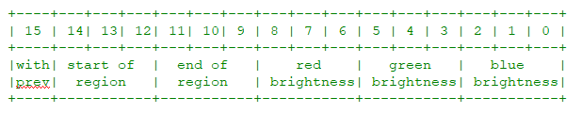
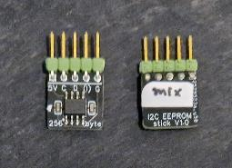
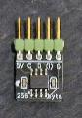
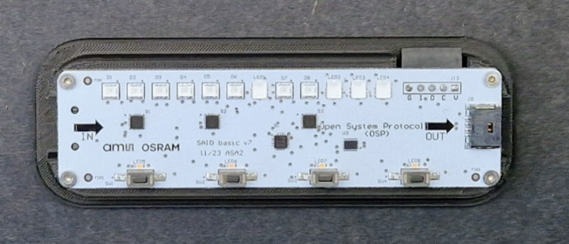
Animation script
Script instructions only have 3 bits for each color, and 3 for a region, so script animations are coarse.
Description
Plays a light show as defined by an animation script
Tries to find a SAID with an I2C bridge with an EEPROM
If there is an external EEPROM stick (I2C address 0x51) it favors that over an internal EEPROM (address 0x50)
If there are multiple (of the same kind, external or internal) the first one is taken
If no EEPROM is found, uses the heartbeat script included in the firmware
If an EEPROM is found, loads the script from the EEPROM and plays that
The internal EEPROM (on the SAIDbasic board) contains the rainbow script
External EEPROMs are flashed with bouncing-block and color-mix
Notes
Ensure the I2C EEPROM stick faces "chip up" otherwise there is a short circuit (see PCB labels)
Safest is to only swap an EEPROM when USB power is removed
The script loading takes place on app start: (1) power cycle, (2) reset, (3) “A” button.
Buttons
The X and Y buttons control the FPS level (frames-per-second animation speed).
Goal
Show that the root MCU can access I2C devices (EEPROM) e.g. for calibration values
External EEPROM with animation scripts
Internal EEPROM with animation scripts
Connector for external EEPROMs
To flash an animation script see https://github.com/ams-OSRAM/OSP_aotop/tree/main/examples/eepromflasher

Slide 6
Running LEDs
Description
There is a "virtual cursor" that runs from the begin of the chain to the end and then back
Chain length and node types are auto detected
Every 25ms the cursor advances one LED and paints that in the current color
Every time the cursor hits the begin or end of the chain, it steps color
Color palette: red, yellow, green, cyan, magenta
Buttons
The X and Y buttons control the dim level (RGB brightness)
Goal
To show that various OSP nodes can be mixed and have color/brightness matched
In this demo, there is no algorithm running using LED color calibration data to stabilize colors over LEDs and over temperature

Slide 7
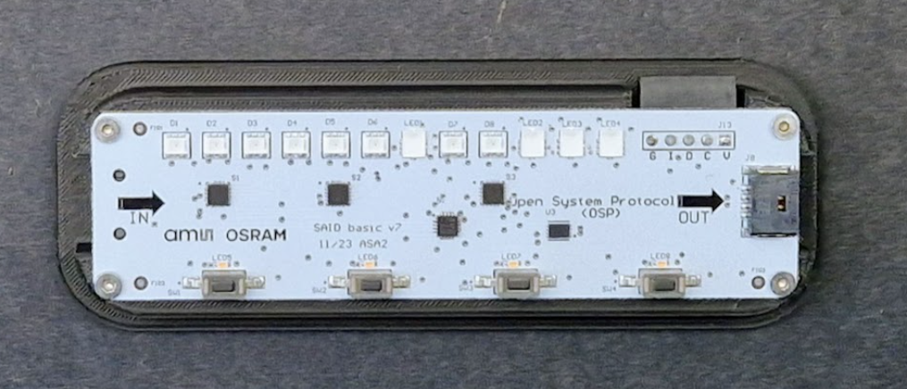
Switch flag
Description
Shows one (static) flag at a time, eg red/white/blue spread over the OSP chain
Tries to find a SAID with an I2C bridge with an I/O-expander (with four buttons and four indicator LEDs)
If there is no I/O-expander, shows four static flags switching on a time basis
If there are multiple I/O-expanders the first one is taken
When an I/O-expander is found the four buttons select which flag to show
The indicator LEDs indicate which button/flag was selected
Buttons
The X and Y buttons control the dim level (RGB brightness)
Notes
When the app quits, the indicator LED switches off
This app adds a command to configure which four flags will be shown
Goal
To show a "sensor" (button) being accessible from the root MCU (the ESP)
I/O Expander I2C to GPIO bridge
Four indicator LEDs (connected as outputs to IOX)
Four buttons (connected as inputs to IOX)

Slide 8
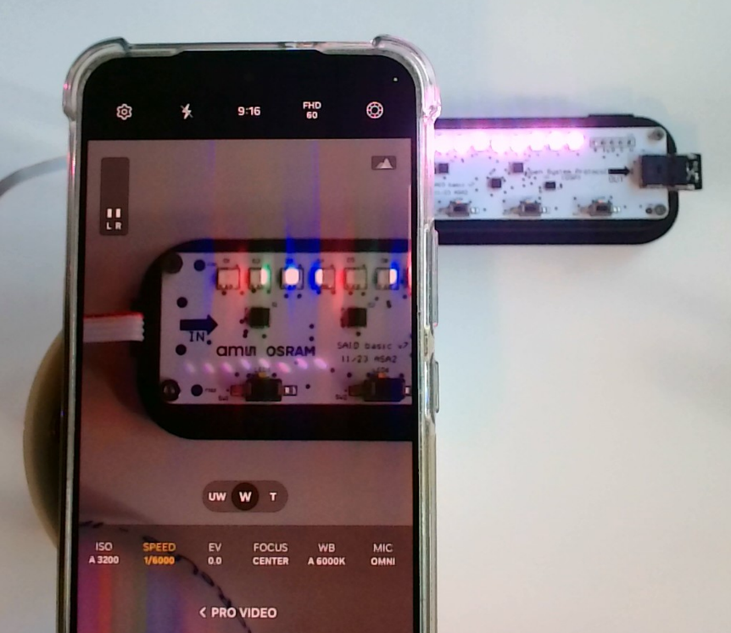
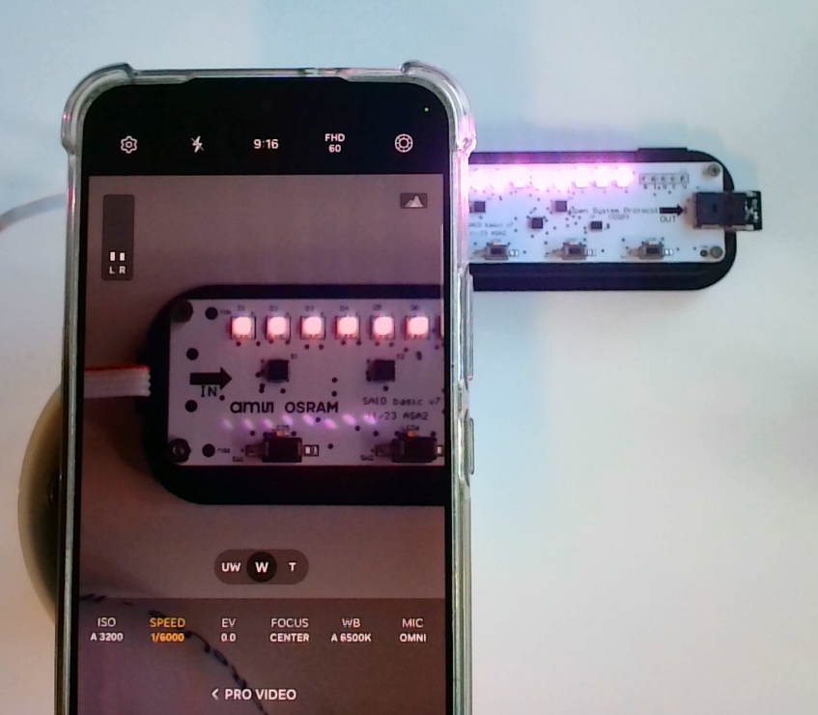
Dithering
Description
The LEDs are in a dimming cycle (dim up, then dim down, then up again, etc).
All LEDs dim synchronously and at the same level (so RGBs look white).
Dithering can be enabled/disabled
Buttons
The X button toggles dim cycling on/off.
The Y button toggles dithering on/off.
Goal
To show the effect of dithering
View the LEDs with e.g. LED Light Flicker Meter https://play.google.com/store/apps/details?id=com.contechity.flicker_meter
Alternatively, view the LEDs with a mobile phone camera “pro mode” video with high framerate
Dithering disabled flicker
Dithering enabled no flicker

